Slide 1

Courier Station
Information Management System
Group 6
杨钧涯
2230026188
单佳影
2230026230
丁书萱
2230026232
肖易林
2230026175
郑植劲翔
2230026222

Slide 2

01
Background
User Requirement
02
03
ER Diagram
Relational Model
04
Normalization
05

Slide 3

01
Background
丁书萱 2230026232

Slide 4

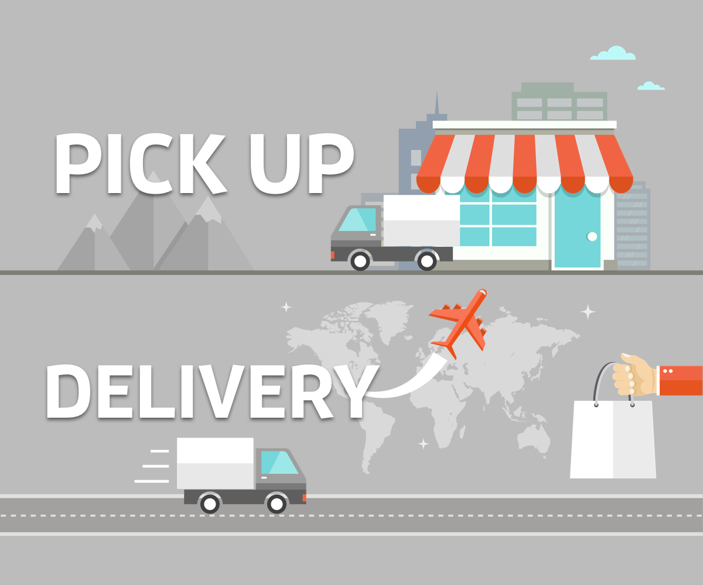
Reliable delivery services
Meet the different needs
Why?
Related to us
Improve the efficiency
Goal

Slide 5
20w users...
Insert all provinces, cities and districts
Realize
Data
Securing connection
Associative deletion

Slide 6
02
User requirement
肖易林 2230026175

Slide 7
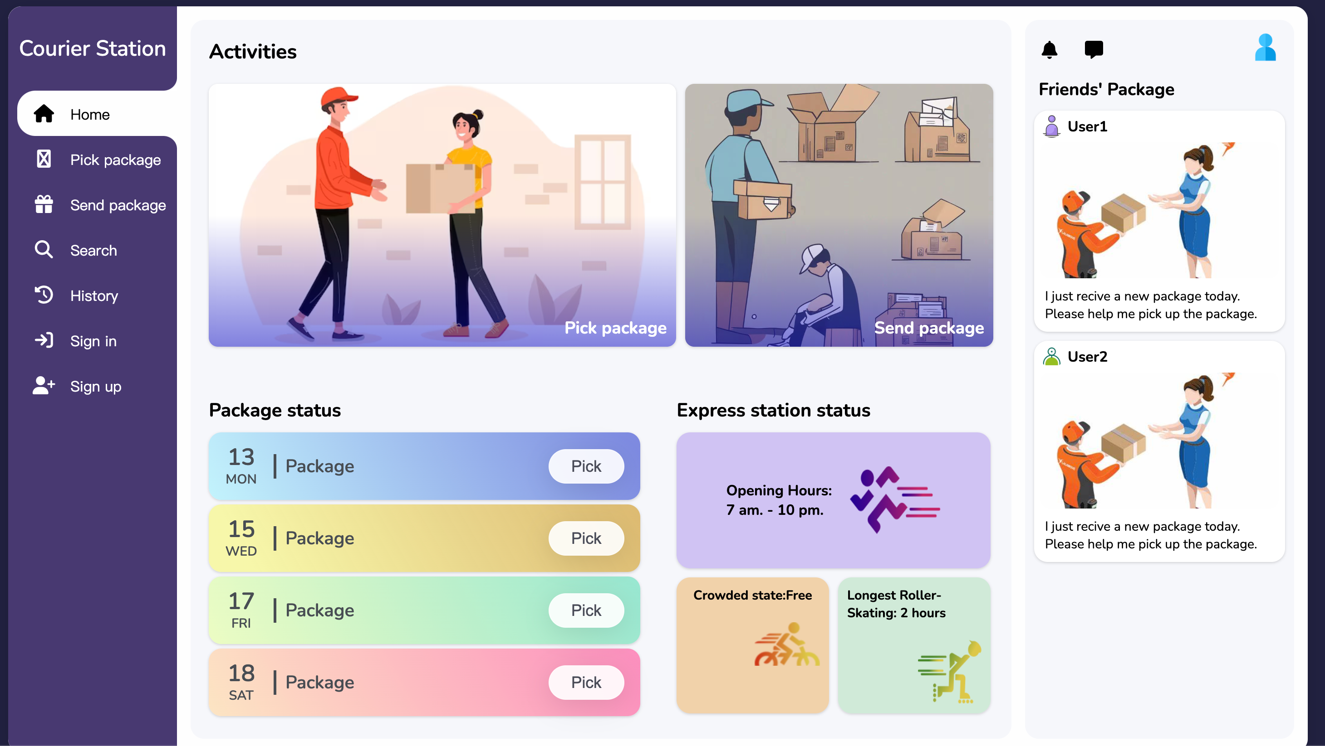
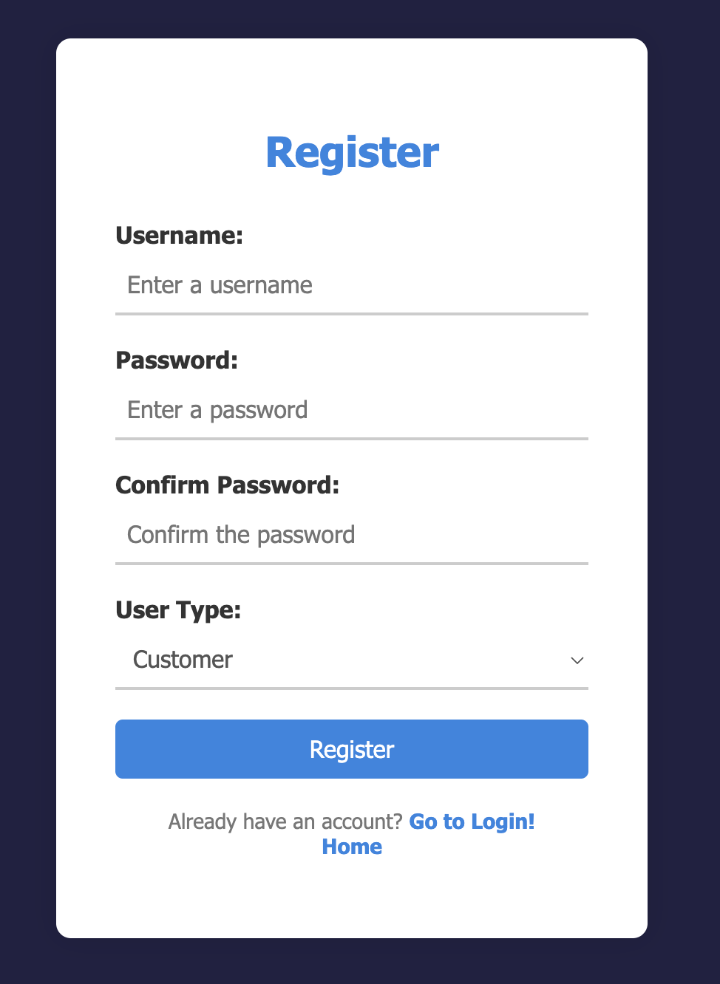
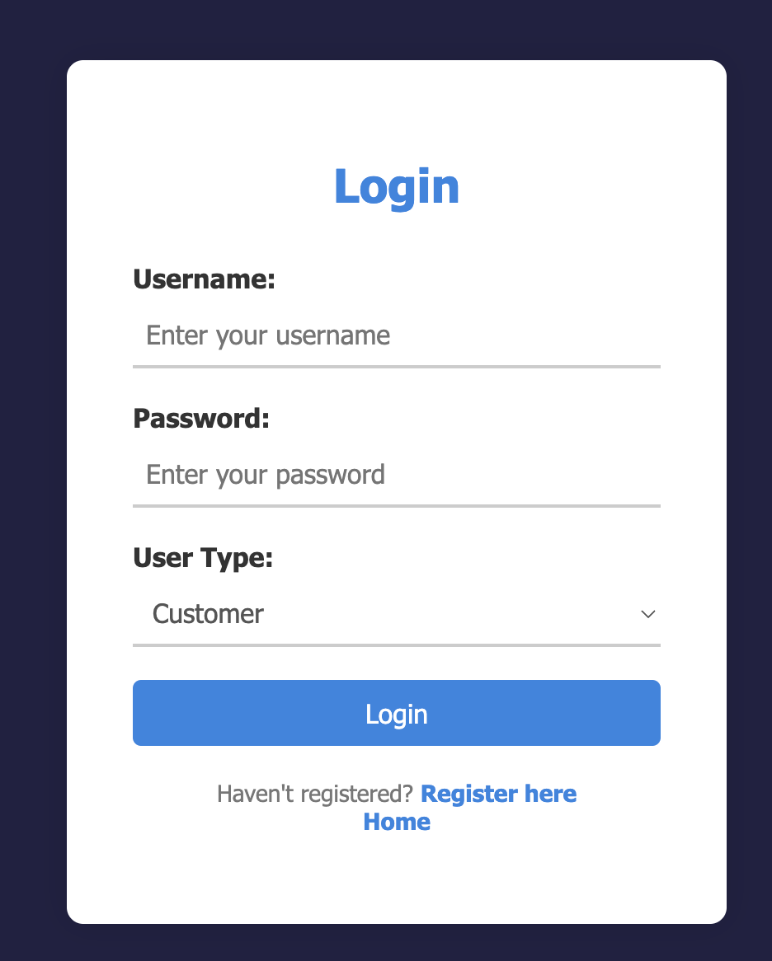
Useful function on the left
The package below the page
Login and registration page
添加标题
Ordinary users page

Slide 8
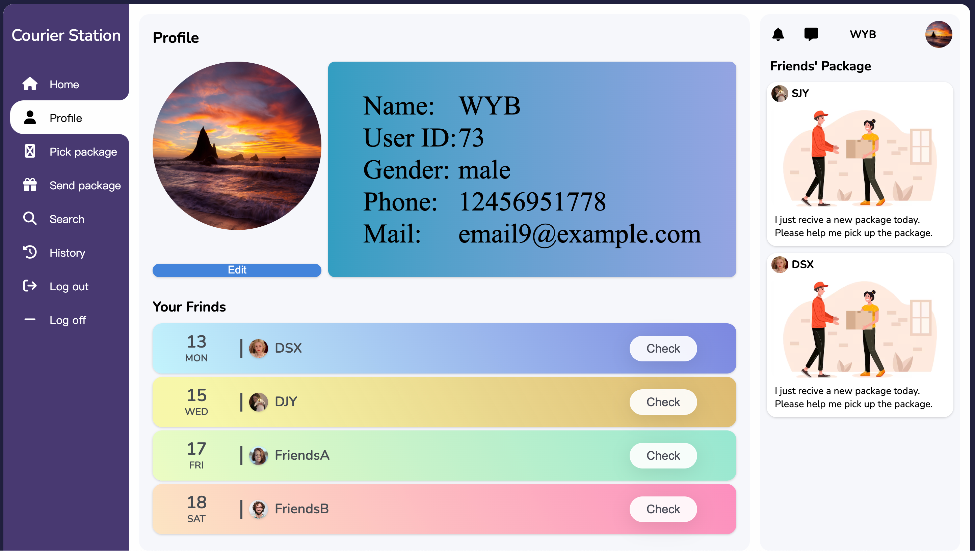
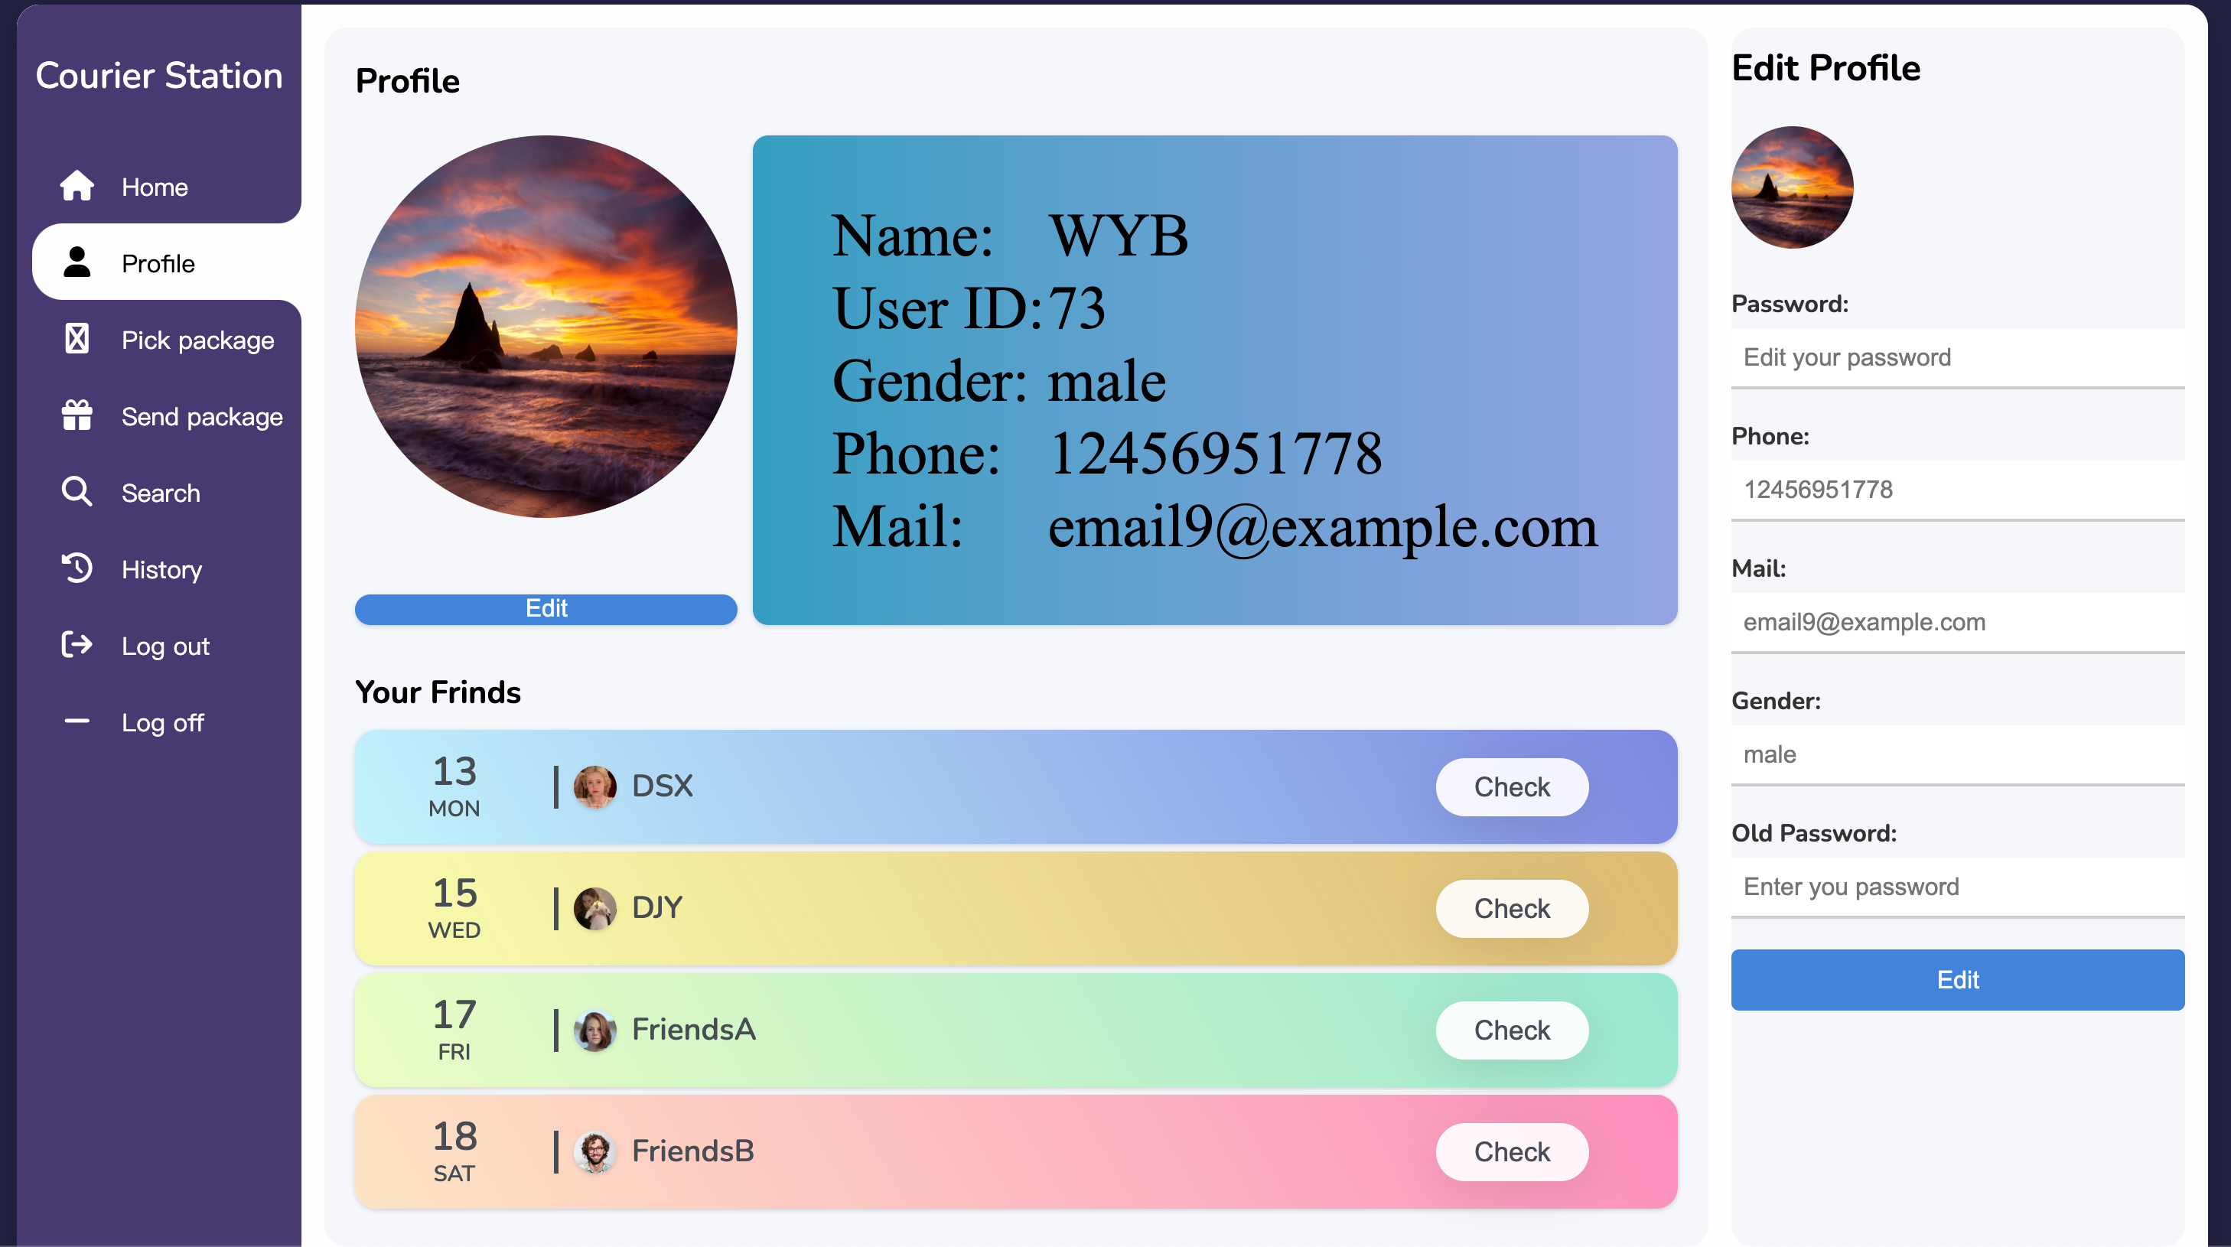
Profile
Clicking on "Edit"

Slide 9
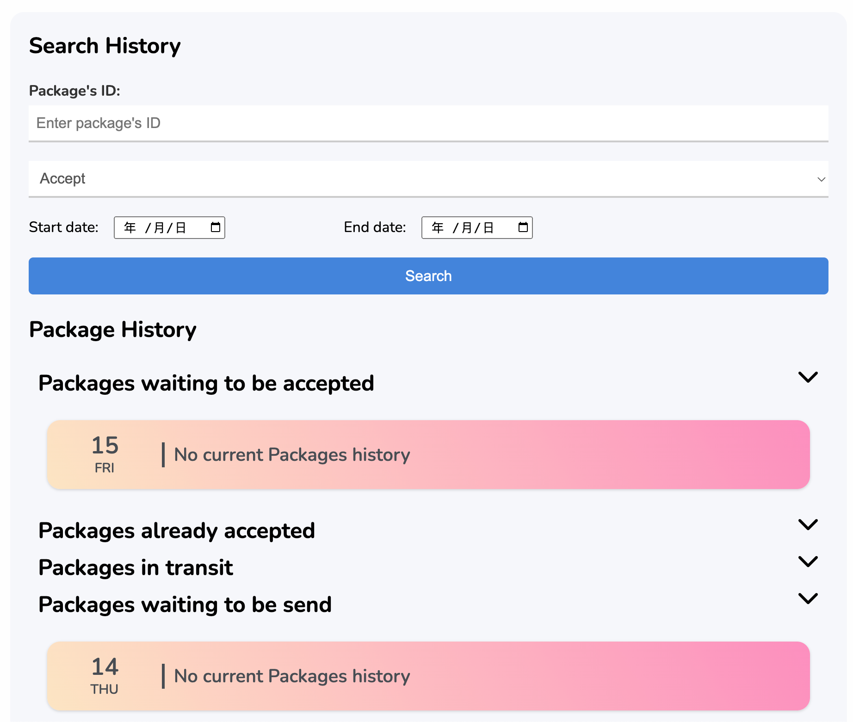
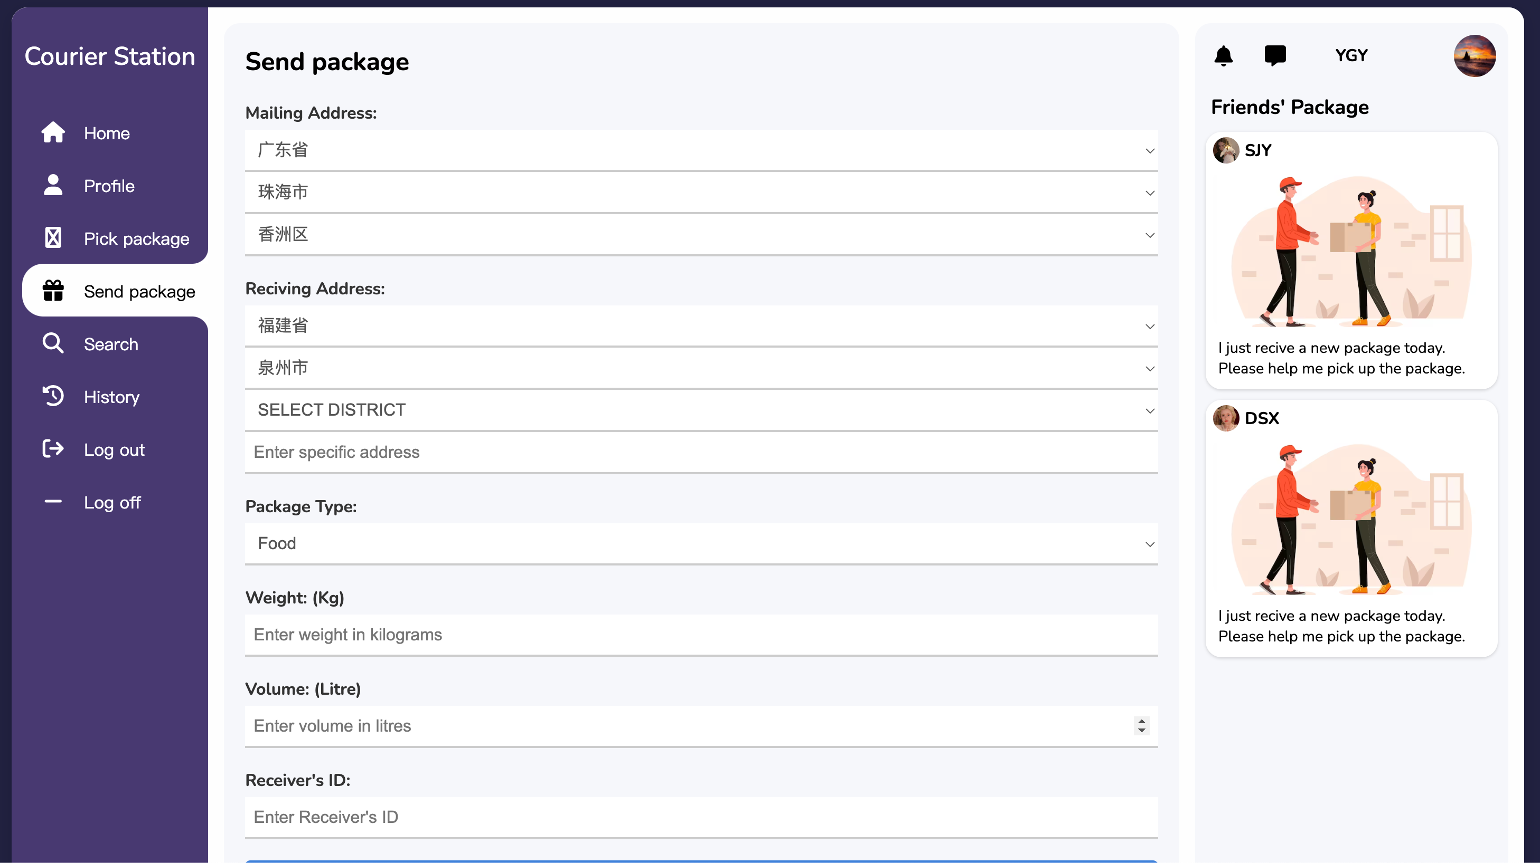
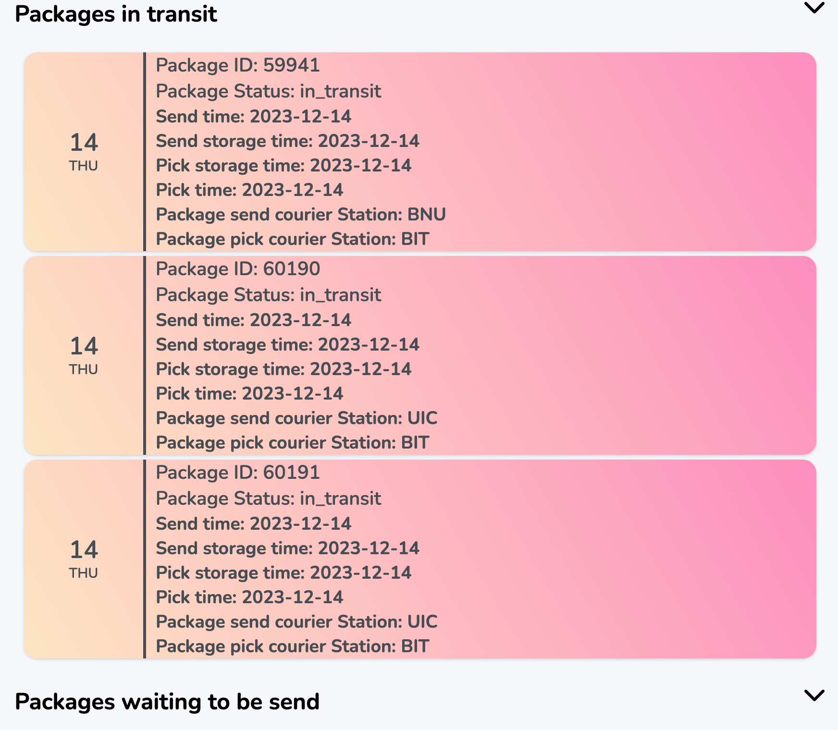
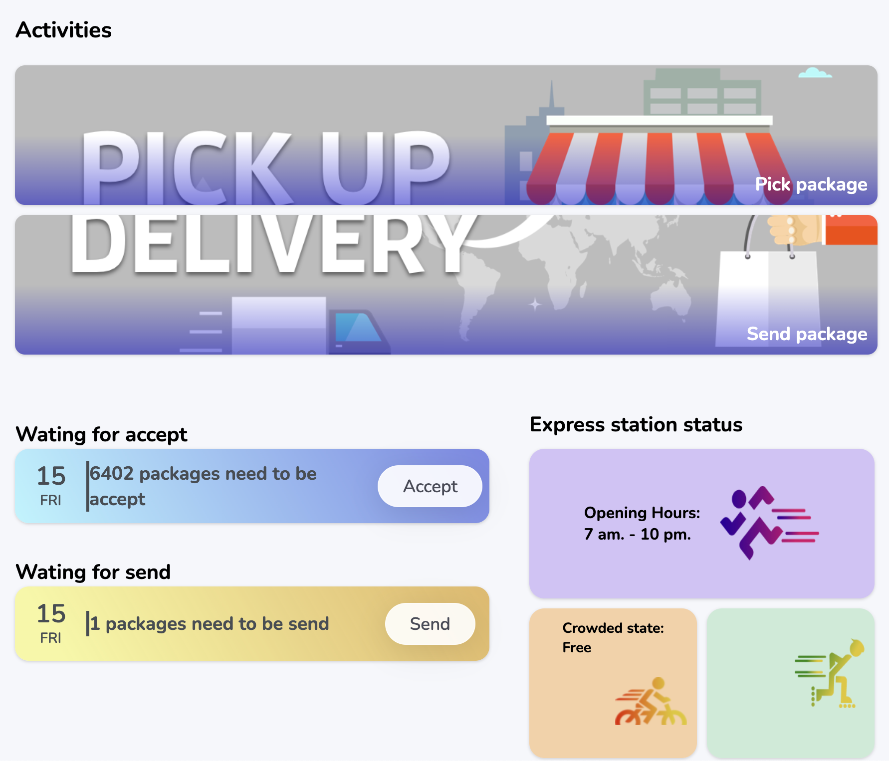
Send package
Select the sender’s and receiver’s information
History
Search the history
There are some packages
A package on administrator page

Slide 10
03
ER-diagram
单佳影 2230026230

Slide 11
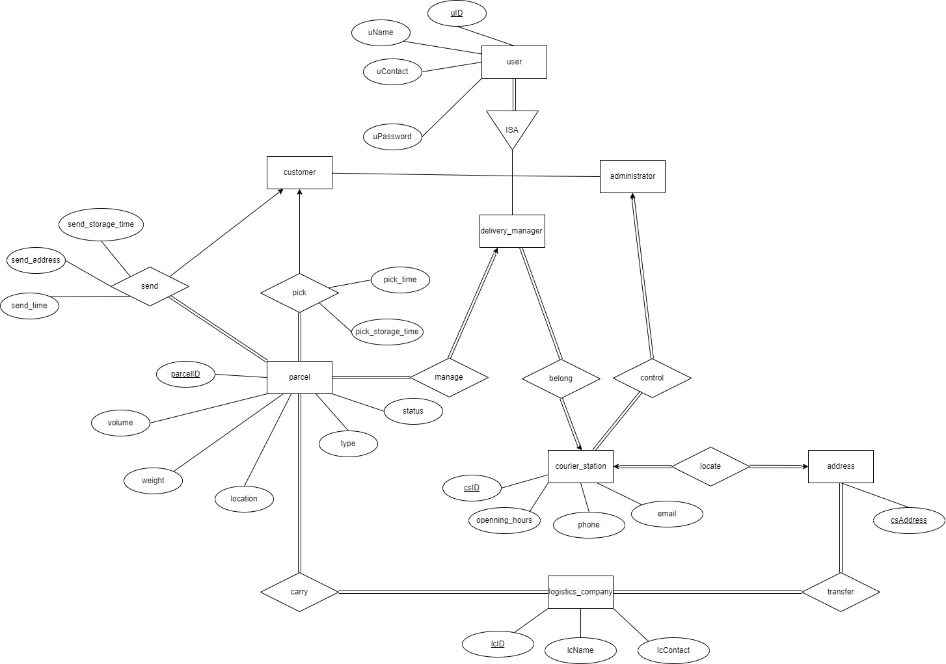
此处添加标题

Slide 12
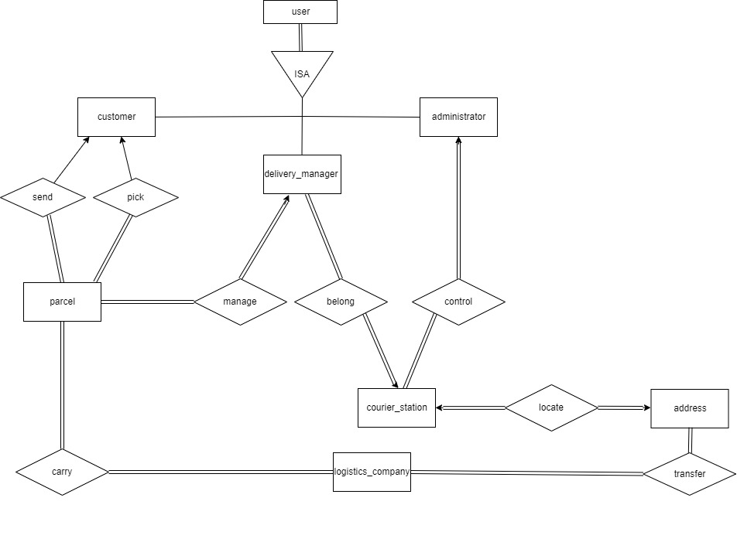
User
Uses uID to login
ISA relationship distinguish the user :
customer
delivery manager
administrator

Slide 13
Parcel
Each parcel ↔ one customer
Each customer ↔ more than one parcel
Each parcel → delivery manager
→logistic company

Slide 14
Courier Station
Each delivery manager
→ one courier station
Administrator
→multiple courier stations.
Each courier station
→ one specific location

Slide 15
04
郑植劲翔 2230026222

Slide 16
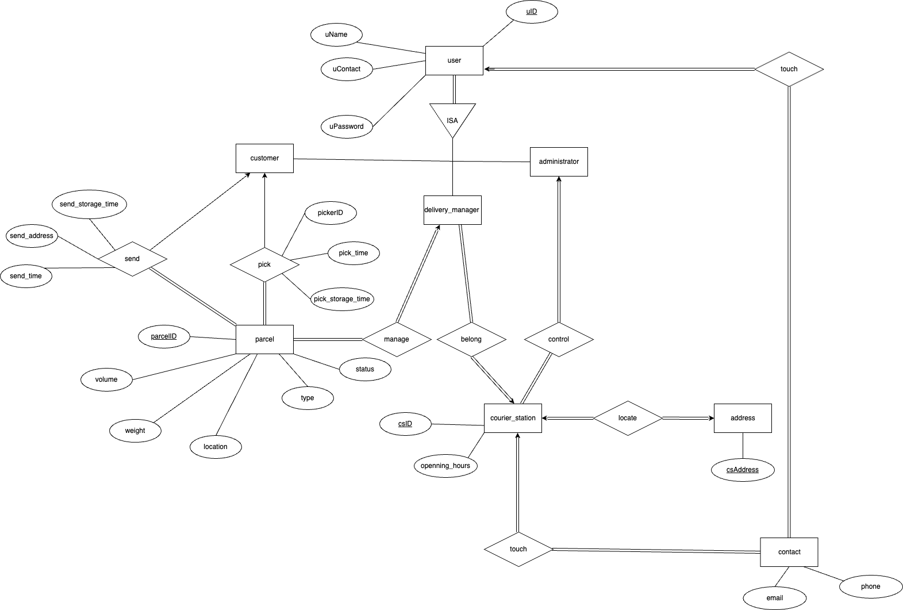
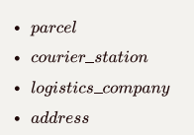
1
For the entity part
· customer
· delivery_manager
· administrator

Slide 17
1
For the relationship part
There is no need to create schemas for red cases
CaseIX
We create an individual schema for each blue relationship set .
CaseX
CaseVII
CaseIII

Slide 18
Logical Design
Then we can get all the schemas below:
- admin = {uID, uphone, umail, uname, upassword, ugender, upicture}
- delivery_manager = {uID, uphone, uemail, uname, upassword, ugender, upicture, csID}
- customer = {uID, uphone, uemail, uname, upassword, ugender, upicture}
- parcel = {pID, volime, weight, status,parcelType, send_address, send_storage_time,
send_time, pick_storage_time, pick_time, cust_send_ID, cust_pick_ID, cadminID}
- courier_station = {csID, start_time, csphone, csemail, csaddress, end_time, adminID}
- logistics_company = {lsID, lsname, lsemail}
- address = {csaddress, csID}
- carry = {lsID, parcelID}
- transfer = {csaddress, lcID}

Slide 19
04
Normalization
杨钧涯 2230026188

Slide 20

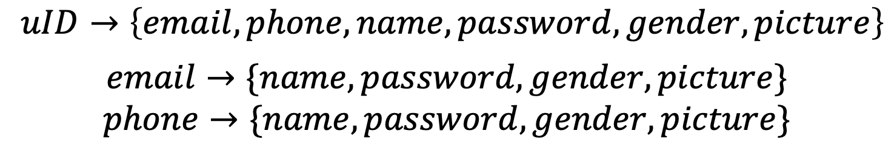
After the logical design, the schemas have already satisfied 1NF
$admin=\{\underline{uID,phone,email,}name,password,gender,picture\}$
Schemas
$courier_manager=\{\underline{uID,phone,email},name,password,gender,picture,csID\}$
$customer=\{\underline{uID,phone,email},name,password,gender,picture\}$
Function dependency
$uID→\left\{email,phone,name,password,gender,picture\right\}$
$$email→\{name,password,gender,picture\}$$
$$phone→\{name,password,gender,picture\}$$

Slide 21
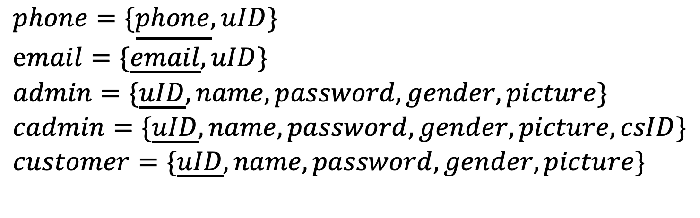
Not in BCNF
$$email→\{name,password,gender,picture\}$$
$$phone→\{name,password,gender,picture\}$$
Email and phone are not superkeys, therefore it violates BCNF
Decomposition
$$phone=\{\underline{phone},uID\} \\ email=\{\underline{email},uID\} \\ admin=\{\underline{uID}, name,password,gender,picture\} \\ cadmin=\{\underline{uID},name,password,gender,picture,csID\} \\ customer=\{\underline{uID},name,password,gender,picture\}$$

Slide 22
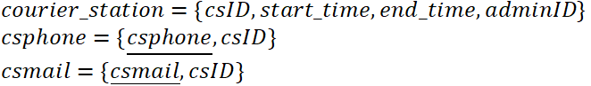
Courier station schema
$$courier_station=\{csID,start_time,csphone,csemail,end_time,adminID\}$$
Functional dependency
$$csID→\{start_time,csphone,csemail,end_time,adminID\}$$
$$csphone→\{start_time,end_time,adminID\}$$
$$csemail→\{start_time,end_time,adminID\}$$
Decomposition

Slide 23
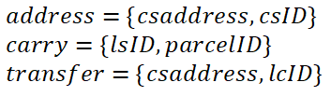
The rest of schemas also satisfied the BCNF
Only 2 attributes

Slide 24
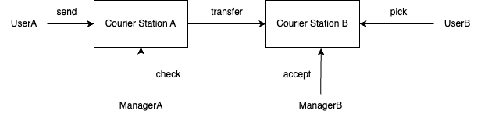
Live Demo
06
Here we will show you
basic send/pick features

Slide 25
Conclusion
07
- Customers can effortlessly pick and send packages, track deliveries in real-time, manage personal information, view order history, and evaluate the quality of service.
Our system offers a range of dynamic shipping options to suit different customer preferences.
- For courier station managers, features such as status updates, site information management, and access to comprehensive historical logs can effectively manage packages. The ability to transfer parcels between sites ensures a smooth flow of parcels through the logistics network.
- In addition, administrators benefit from a centralized view of workstation status and a complete package history, allowing them to monitor and optimize overall system performance.

Slide 26

Thanks

